Slide 1
Chapter 1: Semiconductor Diodes
Robert Boylestad Digital Electronics
Copyright ©2002 by Pearson Education, Inc. Upper Saddle River, New Jersey 07458 All rights reserved.

Slide 2
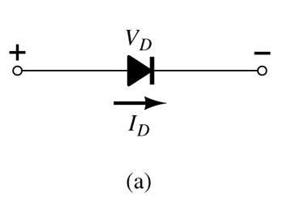
Slide 1
Diodes Simplest Semiconductor Device
It is a 2-terminal device
Robert Boylestad Digital Electronics
Copyright ©2002 by Pearson Education, Inc. Upper Saddle River, New Jersey 07458 All rights reserved.

Slide 3
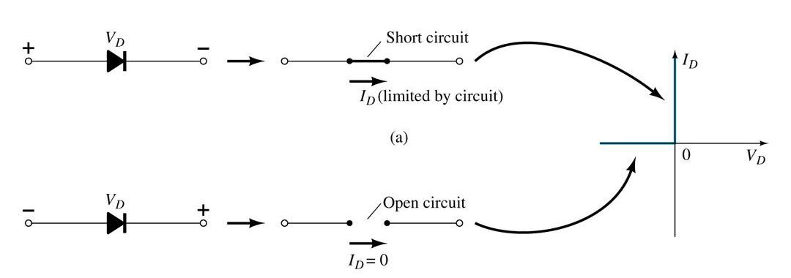
Slide 2
Basic operation Ideally it conducts current in only one direction
and acts like an open in the opposite direction
Robert Boylestad Digital Electronics
Copyright ©2002 by Pearson Education, Inc. Upper Saddle River, New Jersey 07458 All rights reserved.

Slide 4
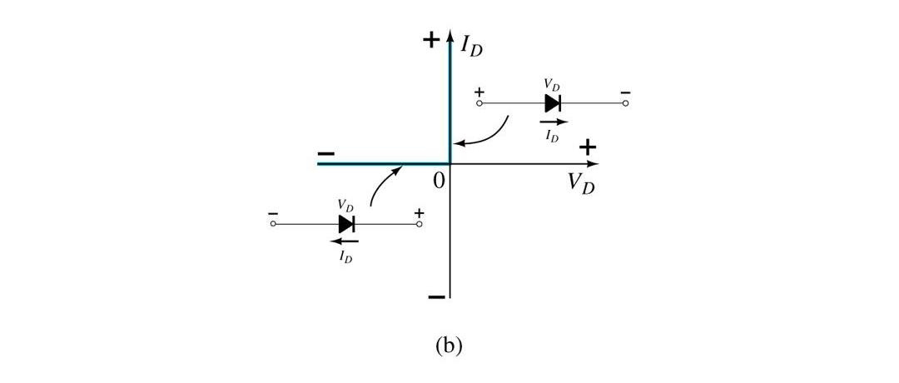
Slide 3
Characteristics of an ideal diode: Conduction Region
Look at the vertical line! In the conduction region, ideally • the voltage across the diode is 0V, • the current is , • the forward resistance (RF) is defined as RF = VF/IF, • the diode acts like a short.
Robert Boylestad Digital Electronics
Copyright ©2002 by Pearson Education, Inc. Upper Saddle River, New Jersey 07458 All rights reserved.

Slide 5
Slide 4
Characteristics of an ideal diode: Non-Conduction Region
Look at the horizontal line! In the non-conduction region, ideally • all of the voltage is across the diode, • the current is 0A, • the reverse resistance (RR) is defined as RR = VR/IR, • the diode acts like open.
Robert Boylestad Digital Electronics
Copyright ©2002 by Pearson Education, Inc. Upper Saddle River, New Jersey 07458 All rights reserved.

Slide 6
Slide 5
Semiconductor Materials
Common materials used in the development of semiconductor devices: • Silicon (Si) • Germanium (Ge)
Robert Boylestad Digital Electronics
Copyright ©2002 by Pearson Education, Inc. Upper Saddle River, New Jersey 07458 All rights reserved.

Slide 7
Slide 6
Doping
The electrical characteristics of Silicon and Germanium are improved by adding materials in a process called doping. The additional materials are in two types: • n-type • p-type
Robert Boylestad Digital Electronics
Copyright ©2002 by Pearson Education, Inc. Upper Saddle River, New Jersey 07458 All rights reserved.

Slide 8
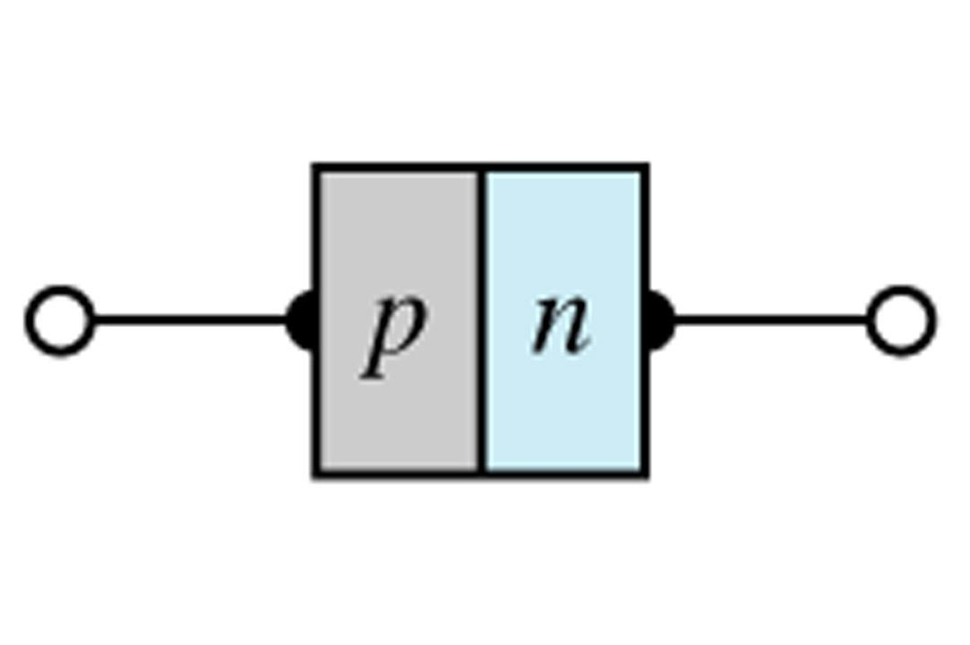
Slide 7
n-type versus p-type
n-type materials make the Silicon (or Germanium) atoms more negative. p-type materials make the Silicon (or Germanium) atoms more positive. Join n-type and p-type doped Silicon (or Germanium) to form a p-n junction.
Robert Boylestad Digital Electronics
Copyright ©2002 by Pearson Education, Inc. Upper Saddle River, New Jersey 07458 All rights reserved.

Slide 9
Slide 8
p-n junction
When the materials are joined, the negatively charged atoms of the n-type doped side are attracted to the positively charged atoms of the p-type doped side. The electrons in the n-type material migrate across the junction to the p-type material (electron flow). Or you could say the ‘holes’ in the p-type material migrate across the junction to the n-type material (conventional current flow). The result is the formation of a depletion layer around the junction.
p
n
depletion layer
Robert Boylestad Digital Electronics
Copyright ©2002 by Pearson Education, Inc. Upper Saddle River, New Jersey 07458 All rights reserved.

Slide 10
Slide 9
Operating Conditions
• No Bias
• Forward Bias
• Reverse Bias
Robert Boylestad Digital Electronics
Copyright ©2002 by Pearson Education, Inc. Upper Saddle River, New Jersey 07458 All rights reserved.

Slide 11
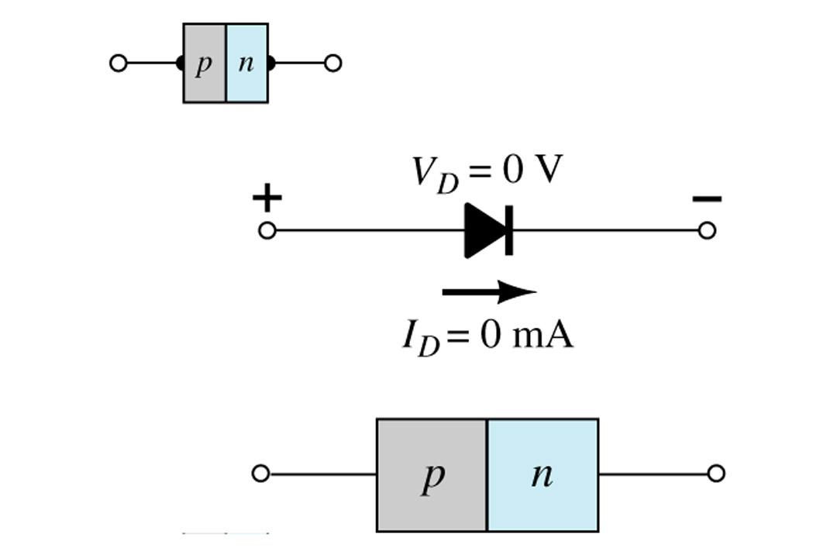
Slide 10
No Bias Condition
No external voltage is applied: V_{D} = 0V and no current is flowing I_{D} = 0A.
Only a modest depletion layer exists.
Robert Boylestad Digital Electronics
Copyright ©2002 by Pearson Education, Inc. Upper Saddle River, New Jersey 07458 All rights reserved.

Slide 12
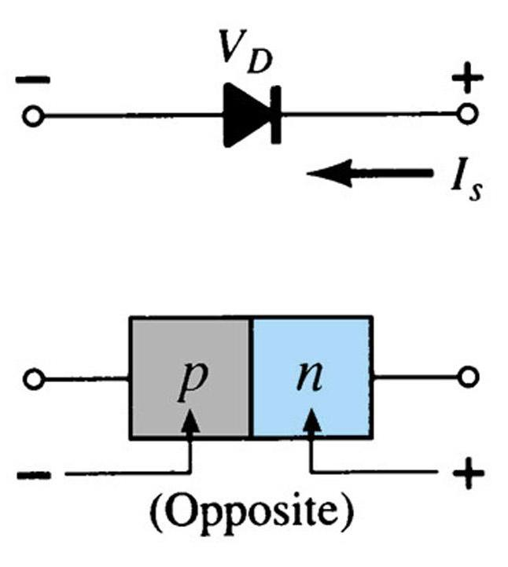
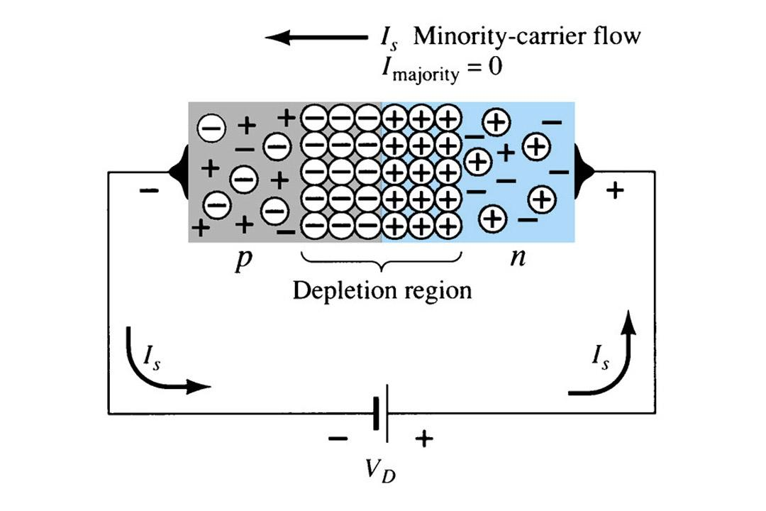
Slide 11
Reverse Bias Condition
External voltage is applied across the p-n junction in the opposite polarity of the p- and n-type materials.
This causes the depletion layer to widen. The electrons in the n-type material are attracted towards the positive terminal and the ‘holes’ in the p-type material are attracted towards the negative terminal.
Robert Boylestad Digital Electronics
Copyright ©2002 by Pearson Education, Inc. Upper Saddle River, New Jersey 07458 All rights reserved.

Slide 13
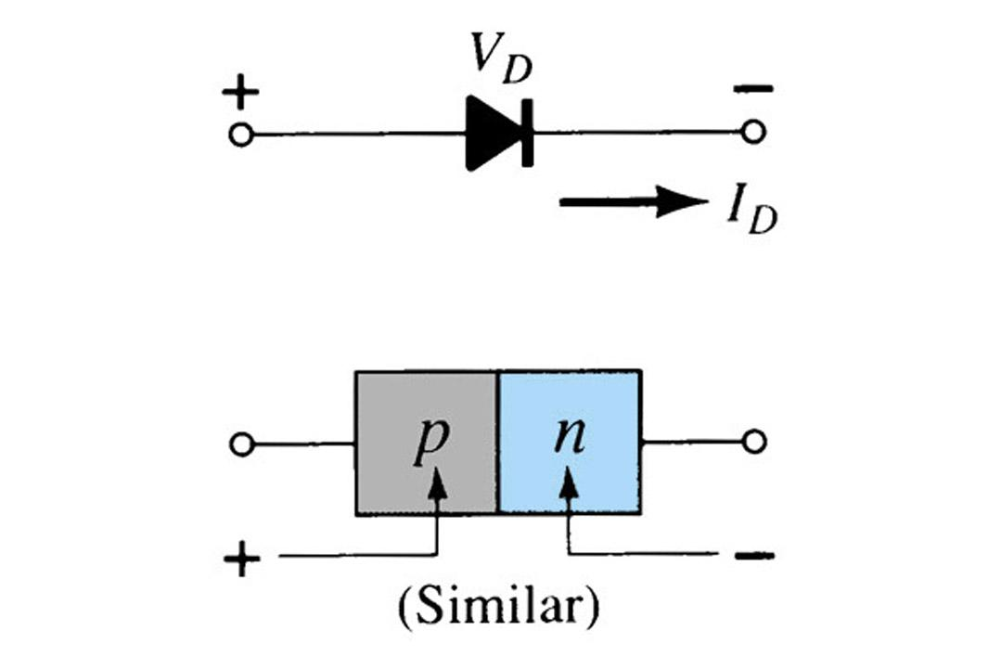
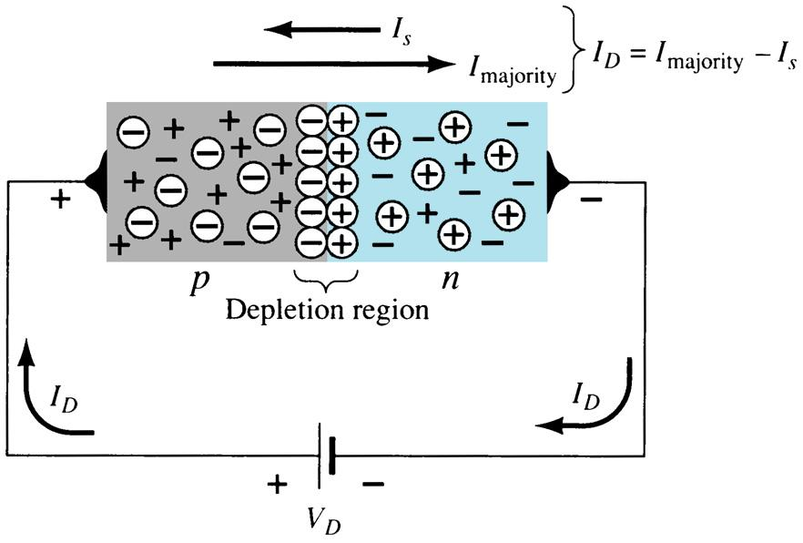
Slide 12
Forward Bias Condition
External voltage is applied across the p-n junction in the same polarity of the p- and n-type materials.
The depletion layer is narrow. The electrons from the n-type material and ‘holes’ from the p-type material have sufficient energy to cross the junction.
Robert Boylestad Digital Electronics
Copyright ©2002 by Pearson Education, Inc. Upper Saddle River, New Jersey 07458 All rights reserved.

Slide 14
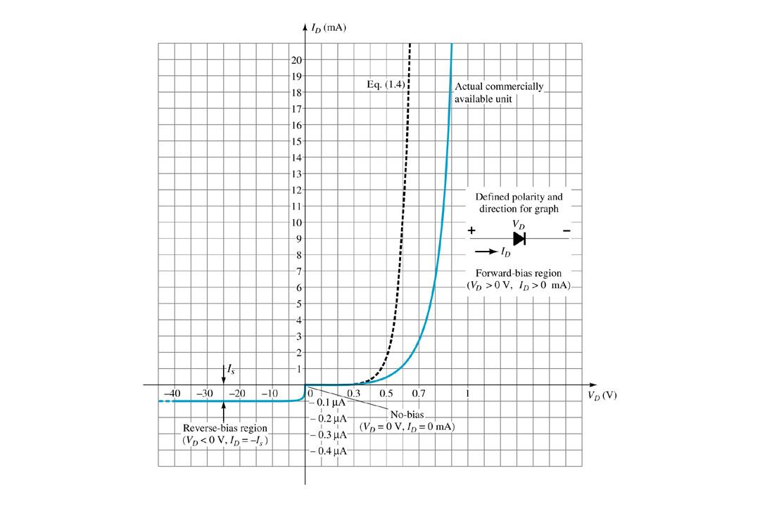
Slide 13
Actual Diode Characteristics
Note the regions for No Bias, Reverse Bias, and Forward Bias conditions. Look closely at the scale for each of these conditions!
Robert Boylestad Digital Electronics
Copyright ©2002 by Pearson Education, Inc. Upper Saddle River, New Jersey 07458 All rights reserved.

Slide 15
Slide 14
Majority and Minority Carriers in Diode
A diode, as any semiconductor device is not perfect! There are two sets of currents:
• Majority Carriers The electrons in the n-type and ‘holes’ in the p-type material are the source of the majority of the current flow in a diode.
• Minority Carriers Electrons in the p-type and ‘holes’ in the n-type material are rebel currents. They produce a small amount of opposing current.
Robert Boylestad Digital Electronics
Copyright ©2002 by Pearson Education, Inc. Upper Saddle River, New Jersey 07458 All rights reserved.

Slide 16
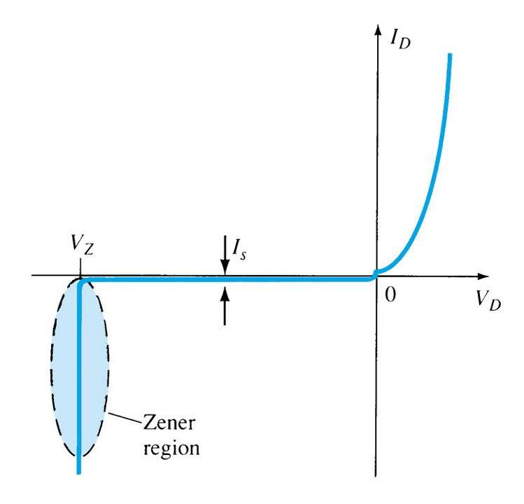
Slide 15
Zener Region
Another detail about the diode is the useful Zener region.
The diode is in the reverse bias condition. At some point the reverse bias voltage is so large the diode breaks down. The reverse current increases dramatically. This maximum voltage is called avalanche breakdown voltage and the current is called avalanche current.
Robert Boylestad Digital Electronics
Copyright ©2002 by Pearson Education, Inc. Upper Saddle River, New Jersey 07458 All rights reserved.

Slide 17
Slide 16
Forward Bias Voltage
The point at which the diode changes from No Bias condition to Forward Bias condition happens when the electron and ‘holes’ are given sufficient energy to cross the p-n junction. This energy comes from the external voltage applied across the diode. The Forward bias voltage required for a • Silicon diode V_{T}  0.7V
• Germanium diode V_{T}  0.3V
Robert Boylestad Digital Electronics
Copyright ©2002 by Pearson Education, Inc. Upper Saddle River, New Jersey 07458 All rights reserved.

Slide 18
Slide 17
Temperature Effects
As temperature increases it adds energy to the diode. It reduces the required Forward bias voltage in Forward Bias condition. It increases the amount of Reverse current in Reverse Bias condition. It increases maximum Reverse Bias Avalanche Voltage. Germanium diodes are more sensitive to temperature variations than Silicon Diodes.
Robert Boylestad Digital Electronics
Copyright ©2002 by Pearson Education, Inc. Upper Saddle River, New Jersey 07458 All rights reserved.

Slide 19
Slide 18
Resistance Levels
Semiconductors act differently to DC and AC currents. There are 3 types of resistances. • DC or Static Resistance • AC or Dynamic Resistance • Average AC Resistance
Robert Boylestad Digital Electronics
Copyright ©2002 by Pearson Education, Inc. Upper Saddle River, New Jersey 07458 All rights reserved.

Slide 20
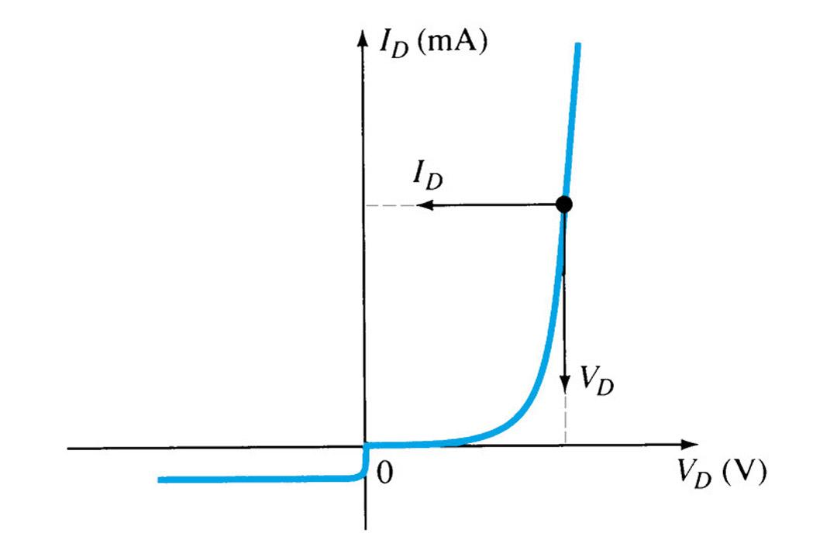
Slide 19
DC or Static Resistance
R_{D} = V_{D}/I_{D} [Formula 1.5] For a specific applied DC voltage V_{D}, the diode will have a specific current I_{D}, and a specific resistance R_{D}. The amount of resistance R_{D}, depends on the applied DC voltage.
Robert Boylestad Digital Electronics
Copyright ©2002 by Pearson Education, Inc. Upper Saddle River, New Jersey 07458 All rights reserved.

Slide 21
Slide 20
AC or Dynamic Resistance
Forward Bias region:
• The resistance depends on the amount of current (I_{D}) in the diode. • The voltage across the diode is fairly constant (26mV for 25C). • rB ranges from a typical 0.1 for high power devices to 2 for low power, general purpose diodes. In some cases rB can be ignored. Reverse Bias region: The resistance is essentially infinite. The diode acts like an open.
[Formula 1.8]
Robert Boylestad Digital Electronics
Copyright ©2002 by Pearson Education, Inc. Upper Saddle River, New Jersey 07458 All rights reserved.

Slide 22
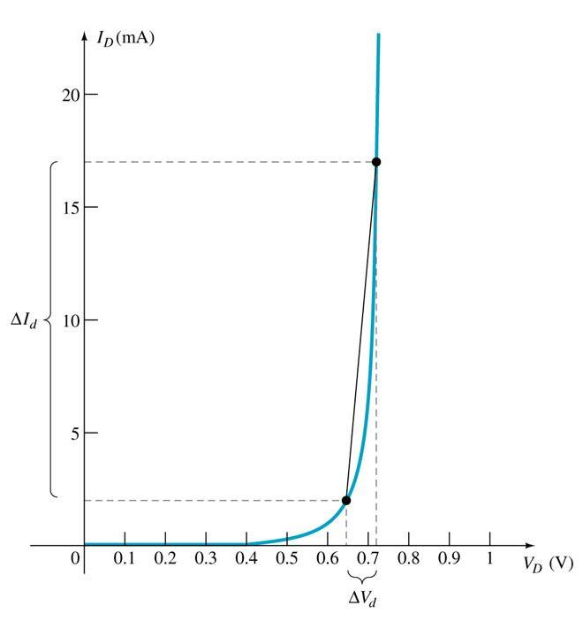
Slide 21
Average AC Resistance
[Formula 1.9]
AC resistance can be determined by picking 2 points on the characteristic curve developed for a particular circuit.
Robert Boylestad Digital Electronics
Copyright ©2002 by Pearson Education, Inc. Upper Saddle River, New Jersey 07458 All rights reserved.

Slide 23
Slide 22
Diode Specification Sheets
Data about a diode is presented uniformly for many different diodes. This makes cross-matching of diodes for replacement or design easier. 1. V_{F}, forward voltage at a specific current and temperature 2. I_{F}, maximum forward current at a specific temperature 3. I_{R}, maximum reverse current at a specific temperature 4. PIV or PRV or V(_{BR}), maximum reverse voltage at a specific temperature 5. Power Dissipation, maximum power dissipated at a specific temperature 6. C, Capacitance levels in reverse bias 7. trr, reverse recovery time 8. Temperatures, operating and storage temperature ranges
Robert Boylestad Digital Electronics
Copyright ©2002 by Pearson Education, Inc. Upper Saddle River, New Jersey 07458 All rights reserved.

Slide 24
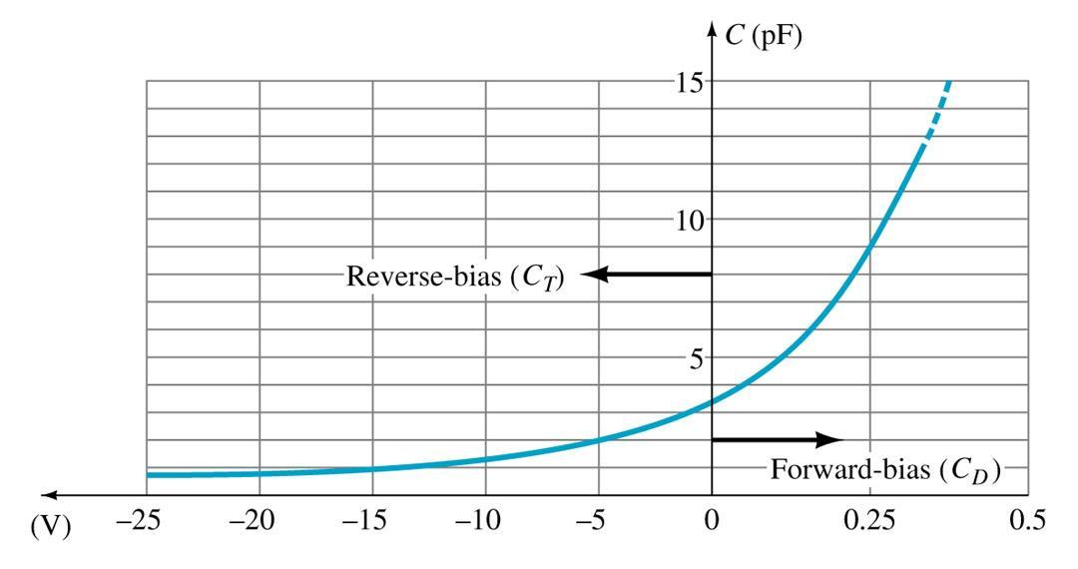
Slide 23
Capacitance
In Reverse Bias the depletion layer is very large. The diode’s strong positive and negative polarities create capacitance, C_{T}. The amount of capacitance depends on the reverse voltage applied. In Forward Bias storage capacitance or diffusion capacitance (C_{D}) exists as the diode voltage increases.
Robert Boylestad Digital Electronics
Copyright ©2002 by Pearson Education, Inc. Upper Saddle River, New Jersey 07458 All rights reserved.

Slide 25
Slide 24
Reverse Recovery Time (trr)
This is the amount of time it takes for the diode to stop conducting once the diode is switched from Forward Bias to Reverse Bias.
Robert Boylestad Digital Electronics
Copyright ©2002 by Pearson Education, Inc. Upper Saddle River, New Jersey 07458 All rights reserved.

Slide 26
Slide 25
Diode Symbol and Notation
Anode is abbreviated – A Cathode is abbreviated – K (because the Cathode end of the diode symbol looks like a backwards K)
Robert Boylestad Digital Electronics
Copyright ©2002 by Pearson Education, Inc. Upper Saddle River, New Jersey 07458 All rights reserved.

Slide 27
Slide 26
Diode Testing
A. Diode Checker B. Ohmmeter C. Curve Tracer
Robert Boylestad Digital Electronics
Copyright ©2002 by Pearson Education, Inc. Upper Saddle River, New Jersey 07458 All rights reserved.

Slide 28
Slide 27
A. Diode Checker
Many DMM’s have a diode checking function. A normal diode will exhibit its Forward Bias voltage (V_{F}). The diode should be tested out of circuit. Silicon diode  0.7V Germanium diode  0.3V
Robert Boylestad Digital Electronics
Copyright ©2002 by Pearson Education, Inc. Upper Saddle River, New Jersey 07458 All rights reserved.

Slide 29
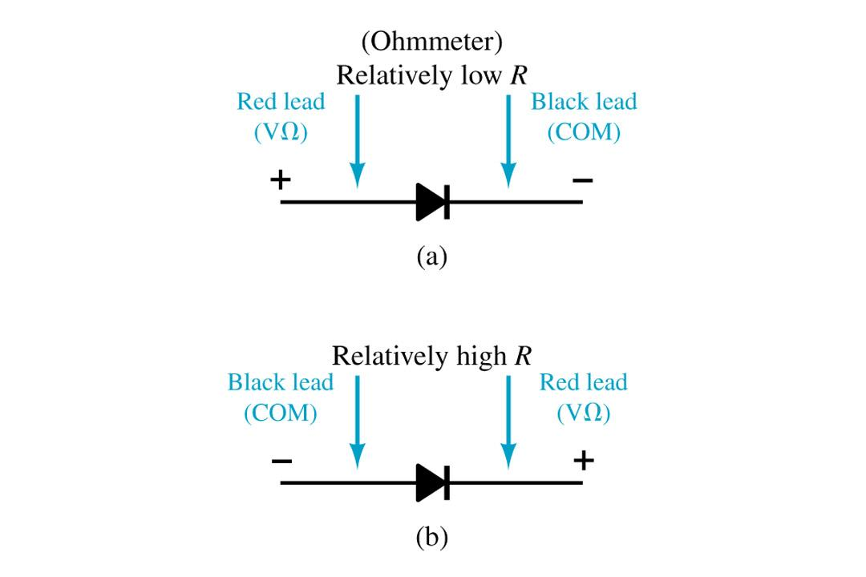
Slide 28
B. Ohmmeter
An ohmmeter set on a low ohms scale can be used to test a diode. A normal diode will have the following readings. The diode should be tested out of circuit.
Robert Boylestad Digital Electronics
Copyright ©2002 by Pearson Education, Inc. Upper Saddle River, New Jersey 07458 All rights reserved.

Slide 30
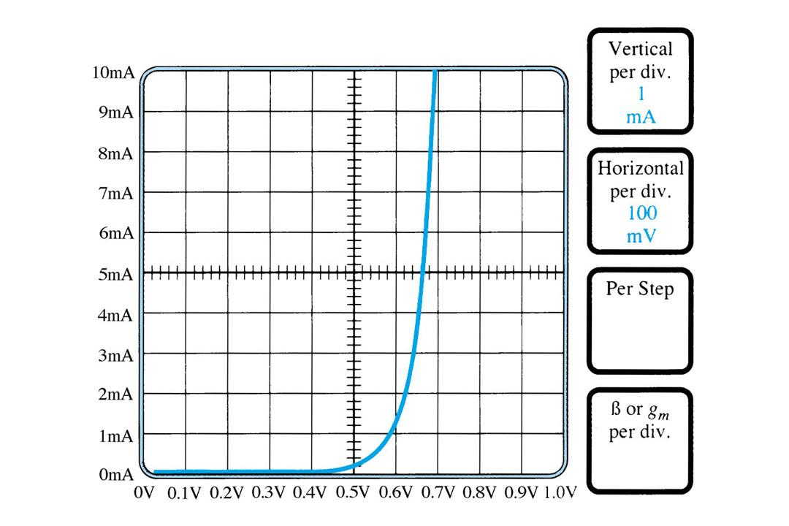
Slide 29
C. Curve Tracer
A curve tracer is a specialized type of test equipment. It will display the characteristic curve of the diode in the test circuit. This curve can be compared to the specifications of the diode from a data sheet.
Robert Boylestad Digital Electronics
Copyright ©2002 by Pearson Education, Inc. Upper Saddle River, New Jersey 07458 All rights reserved.

Slide 31
Slide 30
Other Types of Diodes
1. Zener Diode 2. Light Emitting Diode 3. Diode Arrays
Robert Boylestad Digital Electronics
Copyright ©2002 by Pearson Education, Inc. Upper Saddle River, New Jersey 07458 All rights reserved.

Slide 32
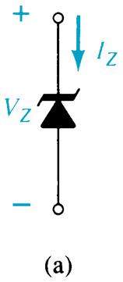
Slide 31
1. Zener Diode
A Zener is a diode operated in reverse bias at the Peak Inverse Voltage (PIV) called the Zener Voltage (V_{Z}).
Symbol
Common Zener Voltages: 1.8V to 200V
Robert Boylestad Digital Electronics
Copyright ©2002 by Pearson Education, Inc. Upper Saddle River, New Jersey 07458 All rights reserved.

Slide 33
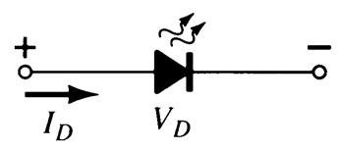
Slide 32
2. Light Emitting Diode (LED)
This diode when forward biased emits photons. These can be in the visible spectrum.
Symbol
The forward bias voltage is higher, usually around 2-3V.
Robert Boylestad Digital Electronics
Copyright ©2002 by Pearson Education, Inc. Upper Saddle River, New Jersey 07458 All rights reserved.

Slide 34
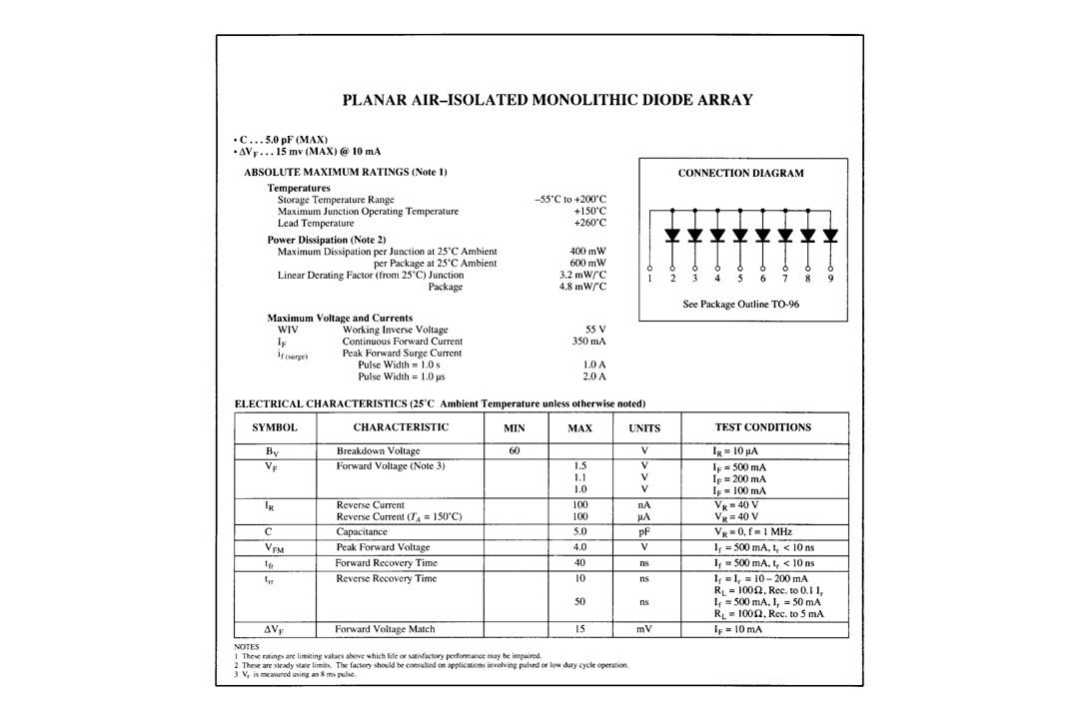
Slide 33
3. Diode Arrays
Multiple diodes can be packaged together in an integrated circuit (IC). A variety of combinations exist. Example of an array:
Robert Boylestad Digital Electronics
Copyright ©2002 by Pearson Education, Inc. Upper Saddle River, New Jersey 07458 All rights reserved.

