Slide 1
Govt. Polytechnic, Dhangar
Presentation on Single Stage Transistor Amplifier

Slide 2
Single Stage Transistor Amplifier
When in an amplifier circuit only one transistor is used for amplifying a weak signal, the circuit is known as single stage amplifier.

Slide 3
However, a practical amplifier consists of a number of single stage amplifiers and hence a complex circuit. Therefore, such a complex circuit can be conveniently split into several single stages and can be effectively analysed

Slide 4
When a weak a.c. signal is applied to the base of the transistor, a small base current starts flowing in the input circuit.
Due to transistor action, a much larger (β times the base current) a.c. current flows through the the load Rc in the output circuit.
Since the value of load resistance Rc is very high, a large voltage will drop across it.
Thus, a weak signal applied in the base circuit appears in amplified form in the collector circuit. In this way the transistor acts as an amplifier.

Slide 5
D.C. and A.C. Equivalent Circuits
To analyse the action of a transistor in a simple way, the analysis is divided into two parts such as; d.c. analysis and a.c. analysis.
In d.c. analysis, we will consider all the d.c. sources at the same time and work out the d.c. currents voltages in the circuit.
Similarly, in a.c. analysis, we will consider all the a.c. sources at the same time and work out the a.c. currents and voltages .
For this analysis let us consider the amplifier circuit shown in fig. below

Slide 6
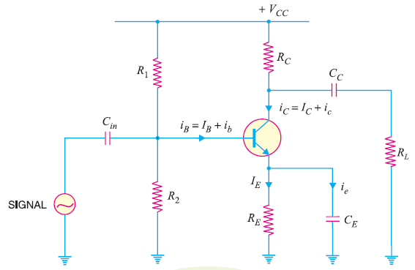

Slide 7
(1) D.C. Equivalent Circuit
In the d.c. equivalent circuit of a transistor amplifier, only d.c. conditions must be considered.
So let us assume there is no signal applied to the circuit.
Since, d.c. currents can not pass through the capacitors, hence, all the capacitors look like open circuits in the d.c. equivalent circuit.
Therefore, to draw the d.c. equivalent circuit, the following two steps are applied to the transistor amplifier circuit :
Make all the a.c. sources zero/Remove all the a.c sources
Open all the capacitors
Applying these two steps to the circuit shown in fig.3, we will get the d.c. equivalent circuit as shown in fig. below.

Slide 8
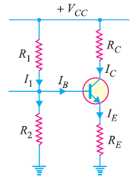

Slide 9
(2) A.C. Equivalent Circuit
In the a.c. equivalent circuit of a transistor amplifier, only a.c. conditions must be considered.
In this case, d.c. voltage is not so important hence, may be assumed to be zero.
The capacitors are used in the circuit to couple or bypass the a.c. signal.
The capacitors are generally taken of large values so as to appear as short circuits to the a.c. signal.
Therefore, to draw the a.c. equivalent circuit, the following two steps are applied to the transistor amplifier circuit :
Make all the d.c. sources zero/Remove all the d.c. sources
Short all the capacitors
Applying these two steps to the circuit shown in fig.3, we will get the a.c. equivalent circuit as shown in fig. below.

Slide 10
