Slide 1
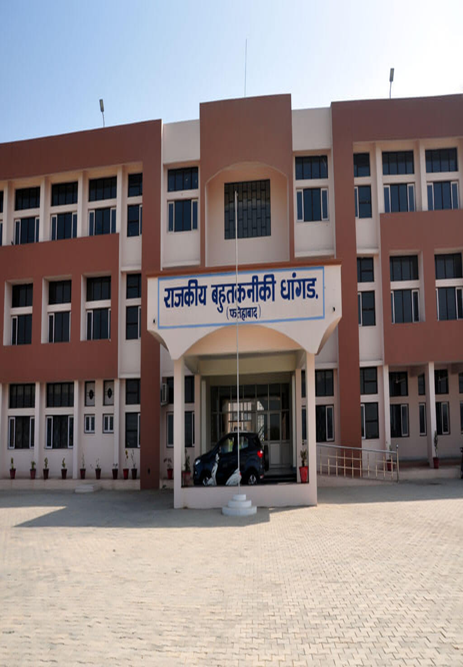

Slide 2
Govt. Poly. Dhangar, Fatehabad
Prepared By:-
Er. Pardeep Nain
Faculty in Electrical Engg. Dept.
Branch:-Electrical Engg.
Sem.:-3rd
Sub:-ECEE

Slide 3
Contents
Estimating & costing
Comparative statement
Market Survey
Profit
Purchase System
Different type of wiring
Comparison between different wiring systems
Protective Devices
Different wiring schemes
Wire Gauge

Slide 4
Estimating and Costing
Estimating is an art of assessment of quantities of different items and cost thereof to plan the amount required for executing a work before actually carrying out the work.
Electrical estimating is a process used by electricians, construction managers and engineers to determine the amount and cost of electricity required for a specific location or process.
An estimating technique is an approach to predicting cost or revenue. Using a consistent methodology is important to achieve reliable and comparable results.

Slide 5
Comparative statement.
Bidding goods and services is important for several reasons. The bidding process:
allows "comparison shopping" for the best pricing and service
allows for an informed and objective choice among potential suppliers
encourages competition among suppliers • provides a standard for comparing price, quality, and service
provides a list of qualified suppliers for future bids
The bid process begins with the development of a set of specifications or objectives. The Contract Administrator (CA) in conjunction with the requester must define the requirements exactly. Colleagues, technical personnel, trade manuals, and suppliers may be consulted for assistance in developing specifications. The requirements are then communicated to the selected suppliers by a Request for Quotation (RFQ) or a Request for Proposal (RFP).

Slide 6
Market Survey
Market research is a continuous process for gathering data on product characteristics, suppliers‘ capabilities and the business practices that surround them plus the analysis of that data to make acquisition decisions. This requires one to collect and analyze information about the market that subsequently can be used to determine whether the need can be met by products or services available in the commercial market; whether commercial practices regarding customizing, modifying products or tailoring services are available to meet customer needs; what are the customary terms and conditions, including warranty, buyer financing, and discounts under which commercial sales are made; and whether the distribution and logistics support capabilities of potential suppliers are sufficient to meet the needs of the government.

Slide 7
Profit
Estimating the cost of labor for electrical construction can vary greatly from project to project, depending on the installation crew’s experience and the complexity of the project. Charging an hourly installation rate is common for electrical contractors until installation data (number of hours per installer for job completion) can be collected and projects can be estimated based on the amount of work. Electrical contractors are responsible for installing, repairing, and maintaining electrical systems in homes and commercial buildings. Due to the differences in skills and costs between home systems and commercial systems, most companies will focus solely on either residential or commercial work. Fortunately, the process of pricing an electrical job is similar no matter what type of building is involved. For those with a basic understanding of construction and electricity, it is fairly easy to price an electrical job and develop an appropriate estimate.

Slide 8
Purchase System
A method used by businesses to buy products and/or services. A purchasing system manages the entire acquisition process, from requisition, to purchase order, to product receipt, to payment. Purchasing systems are a key component of effective inventory management in that they monitor existing stock and help companies determine what to buy, how much to buy and when to buy it. A popular purchasing system is based on economic order quantity models.

Slide 9
Different Types of Electrical Wiring Systems
Cleat wiring
Casing and capping wiring
Batten
Conduit wiring
i) Surface or open Conduit type
ii) concealed or underground type Conduit

Slide 10
Cleat Wiring
This system of wiring comprise of ordinary VIR or PVC insulated wires (occasionally, sheathed and weather proof cable) braided and compounded held on walls or ceilings by means of porcelain cleats, Plastic or wood.
Cleat wiring system is a temporary wiring system therefore it is not suitable for domestic premises. The use of cleat wiring system is over nowadays.

Slide 11
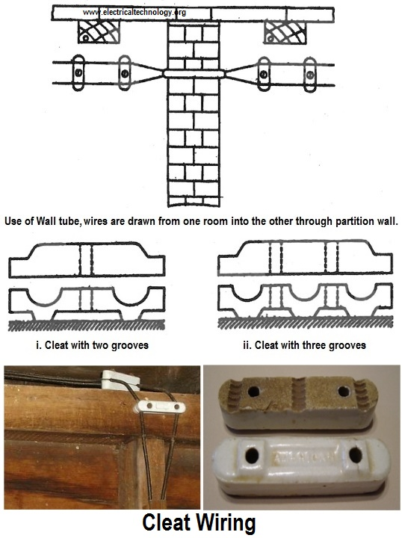

Slide 12
Advantages of Cleat Wiring
It is simple and cheap wiring system
Most suitable for temporary use i.e. under construction building or army camping
As the cables and wires of cleat wiring system is in open air, Therefore fault in cablescan be seen and repair easily.
Cleat wiring system installation is easy and simple.
Customization can be easily done in this wiring system e.g. alteration and addition.
Inspection is easy and simple

Slide 13
Disadvantages of Cleat Wiring
Appearance is not so good.
Cleat wiring can’t be use for permanent use because, Sag may be occur after sometime of the usage.
In this wiring system, the cables and wiring is in open air, therefore, oil, Steam, humidity, smoke, rain, chemical and acidic effect may damage the cables and wires.
it is not lasting wire system because of the weather effect , risk of fire and wear & tear.
it can be only used on 250/440 Volts on low temperature.
There is always a risk of fire and electric shock.
it can’t be used in important and sensitive location and places.
It is not lasting, reliable and sustainable wiring system.

Slide 14
Casing and Capping wiring
Casing and Capping wiring system was famous wiring system in the past but, it is considered obsolete this days because of Conduit and sheathed wiring system. The cables used in this kind of wiring were either VIR or PVC or any other approved insulated cables.
The cables were carried through the wooden casing enclosures. The casing is made up of a strip of wood with parallel grooves cut length wise so as to accommodate VIR cables. The grooves were made to separate opposite polarity. the capping (also made of wood) used to cover the wires and cables installed and fitted in the casing

Slide 15
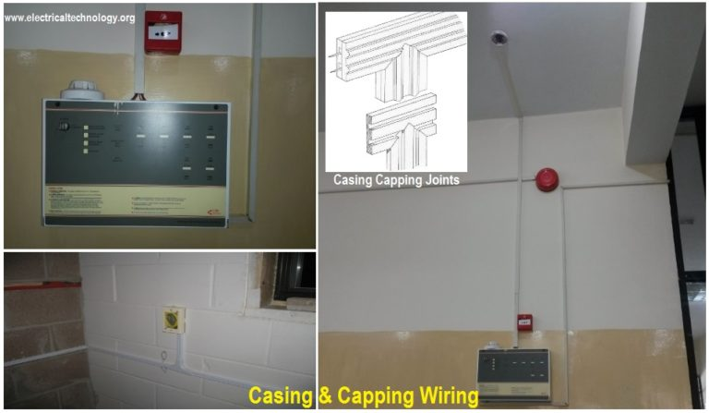

Slide 16
Advantages of Casing Capping Wiring
It is cheap wiring system as compared to sheathed and conduit wiring systems.
It is strong and long-lasting wiring system.
Customization can be easily done in this wiring system.
If Phase and Neutral wire is installed in separate slots, then repairing is easy.
Stay for long time in the field due to strong insulation of capping and casing..
It stays safe from oil, Steam, smoke and rain.
No risk of electric shock due to covered wires and cables in casing & capping.

Slide 17
Disadvantages Casing Capping Wiring
There is a high risk of fire in casing & capping wiring system.
Not suitable in the acidic, alkalies and humidity conditions
Costly repairing and need more material.
Material can’t be found easily in the contemporary
White ants may damage the casing & capping of wood.

Slide 18
Batten Wiring
Single core or double core or three core TRS cables with a circular oval shape cables are used in this kind of wiring. Mostly, single core cables are preferred. TRS cables are chemical proof, water proof, steam proof, but are slightly affected by lubricating oil. The TRS cables are run on well seasoned and straight teak wood batten with at least a thickness of 10mm.
The cables are held on the wooden batten by means of tinned brass link clips (buckle clip) already fixed on the batten with brass pins and spaced at an interval of 10cm for horizontal runs and 15cm for vertical runs.

Slide 19
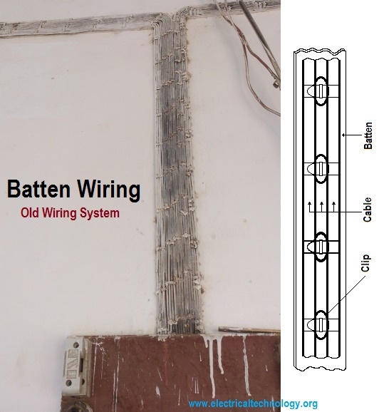

Slide 20
Advantages of Batten Wiring
Wiring installation is simple and easy
cheap as compared to other electrical wiring systems
Paraphrase is good and beautiful
Repairing is easy
strong and long-lasting
Customization can be easily done in this wiring system.
less chance of leakage current in batten wiring system

Slide 21
Disadvantages of Batten Wiring
Can’t be install in the humidity, Chemical effects, open and outdoor areas.
High risk of firs
Not safe from external wear & tear and weather effects (because, the wires are openly visible to heat, dust, steam and smoke.
Heavy wires can’t be used in batten wiring system.
Only suitable below then 250V.
Need more cables and wires.

Slide 22
Conduit Wiring
There are two additional types of conduit wiring according to pipe installation
i) Surface Conduit Wiring
ii) Concealed Conduit Wiring
i) Surface Conduit Wiring
If conduits installed on roof or wall, It is known as surface conduit wiring. in this wiring method, they make holes on the surface of wall on equal distances and conduit is installed then with the help of rawal plugs.
ii) Concealed Conduit wiring
If the conduits is hidden inside the wall slots with the help of plastering, it is called concealed conduit wiring. In other words, the electrical wiring system inside wall, roof or floor with the help of plastic or metallic piping is called concealed conduit wiring. obliviously, It is the most popular, beautiful, stronger and common electrical wiring system nowadays.

Slide 23
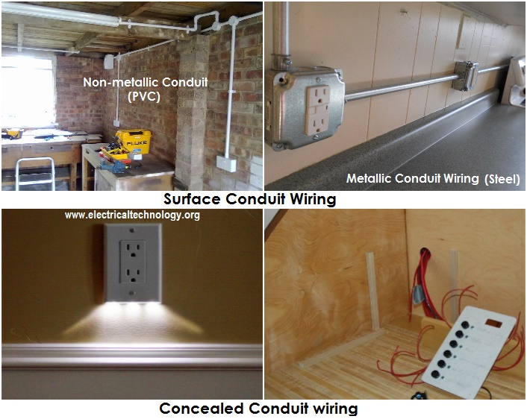

Slide 24
Advantage of Conduit Wiring Systems
It is the safest wiring system (Concealed conduit wring)
Appearance is very beautiful (in case of concealed conduit wiring)
No risk of mechanical wear & tear and fire in case of metallic pipes.
Customization can be easily done according to the future needs.
Repairing and maintenance is easy.
There is no risk of damage the cables insulation.
it is safe from corrosion (in case of PVC conduit) and risk of fire.
It can be used even in humidity , chemical effect and smoky areas.
No risk of electric shock (In case of proper earthing and grounding of metallic pipes).
It is reliable and popular wiring system.
sustainable and long-lasting wiring system

Slide 25
Disadvantages of Conduit Wiring Systems
It is expensive wiring system (Due to PVC and Metallic pipes, Additional earthing for metallic pipes Tee(s) and elbows etc.
Very hard to find the defects in the wiring.
installation is not easy and simple.
Risk of Electric shock (In case of metallic pipes without proper earthing system)
Very complicated to manage additional connection in the future.

Slide 26
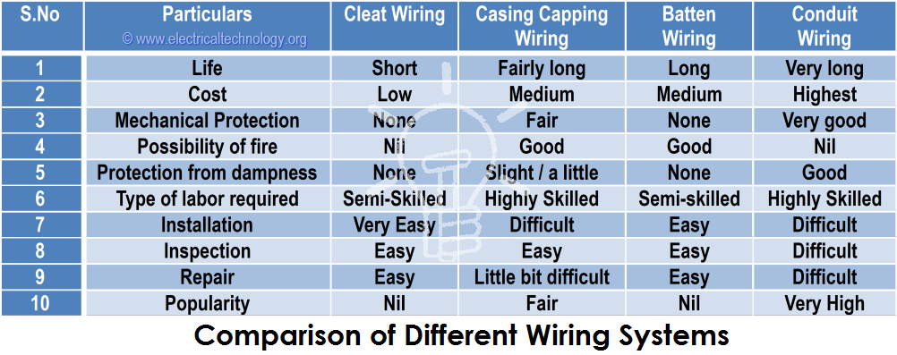
Comparison between Different Wiring Systems

Slide 27
Methods of Electrical Wiring Systems
i) Joint box system or Tee system
ii) Loop – in system
i) Joint Box or Tee or Jointing System
In this method of wiring, connections to appliances are made through joints. These joints are made in joint boxes by means of suitable connectors or joints cutouts. This method of wiring doesn’t consume too much cables size.
You might think because this method of wiring doesn’t require too much cable it is therefore cheaper. It is of course but the money you saved from buying cables will be used in buying joint boxes, thus equation is balanced. This method is suitable for temporary installations and it is cheap.

Slide 28
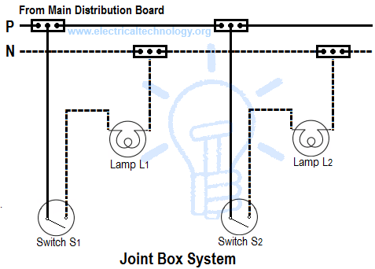

Slide 29
ii) Loop-in or Looping System
This method of wiring is universally used in wiring. Lamps and other appliances are connected in parallel so that each of the appliances can be controlled individually. When a connection is required at a light or switch, the feed conductor is looped in by bringing it directly to the terminal and then carrying it forward again to the next point to be fed.
The switch and light feeds are carried round the circuit in a series of loops from one point to another until the last on the circuit is reached. The phase or line conductors are looped either in switchboard or box and neutrals are looped either in switchboard or from light or fan. Line or phase should never be looped from light or fan.

Slide 30
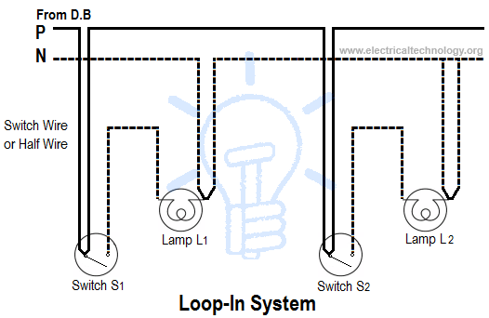

Slide 31
Advantages of Loop-In Method of Wiring
Disadvantages of Loop-In Method of Wiring
It doesn’t require joint boxes and so money is saved
In loop – in systems, no joint is concealed beneath floors or in roof spaces.
Fault location is made easy as the points are made only at outlets so that they are accessible.
Length of wire or cables required is more and voltage drop and copper losses are therefore more
Looping – in switches and lamp holders is usually difficult.

Slide 32
Electrical Protective Device
A device used to protect equipment, machinery, components and devices, in electrical and electronic circuit, against short circuit, over current and earth fault, is called as protective devices.

Slide 33
Types of Protective Device
1.Fuse Wire or Fuse
2.MCB – Miniature circuit breaker
3.ELCB – Earth Leakage Circuit Breaker

Slide 34
Fuse
Fuse generally means a fuse wire, placed in a fuse holder. It is a safety device, which protects electrical and electronic circuit against over loads, short circuit and earth faults.
The fuse link or fuse wire is made of low resistivity material and low melting point.
Operation of a Fuse –
Fuse is a short length of wire designated to melt and separate in case of excessive current.
The fuse is connected in the phase of the supply.
It is always connected in series with the circuit / components that need to be protected.
When the current drawn by the circuit exceeds the rated current of the fuse wire, the fuse wire melts and breaks. This disconnects the supply from the circuit and thus protects the circuit and the components in the circuit.

Slide 35
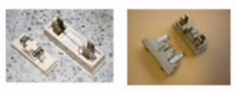
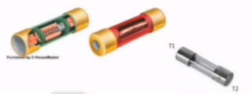
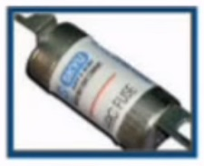
Fuse
Cartridge Fuse
HRC

Slide 36
MINIATURE CIRCUIT BREAKER
It is safety device which work magneto thermic release principle. It is connected in the phase, between the supply and load. It is manufactured in standard rating of 6A to 40 A. We can see it on the meter board of each and every house.
When the current drawn by load exceeds the rated value, it acts and trips the circuit, the protecting the apparatus, operator and appliance.

Slide 37
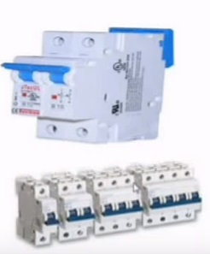
MCB

Slide 38
Advantages of MCB
They act and open the circuit in less than 5 milli seconds.
Automatic switch off under overload and short circuit condition
No fuse to replace or rewire. It needs no repairs.
Supply is restored by resetting it again

Slide 39
EARTH LEAKAGE CIRCUIT BREAKER
This is a domestic safety device,which trips the circuit when there is a small leakage to earth or body of the appliance.Thus it protects the operator from shocks and accidents.This is connected in the circuit of the appliance to be protected.
There are two types of ELCB
1. Voltage Earth Leakage Circuit Breaker
2. Current Earth Leakage Circuit Breaker

Slide 40
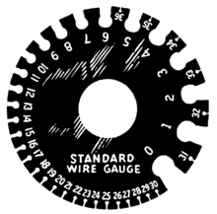
Wire gauge
Wire gauge is a measurement of wire diameter.

