Slide 7
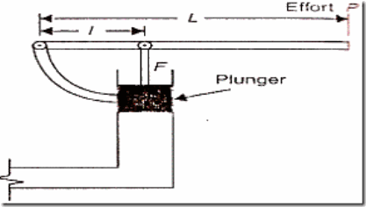
SECOND APPLICATION OF PASCAL’s LAW
LEVRAGE OF HYDRAULIC PRESS

Slide 13
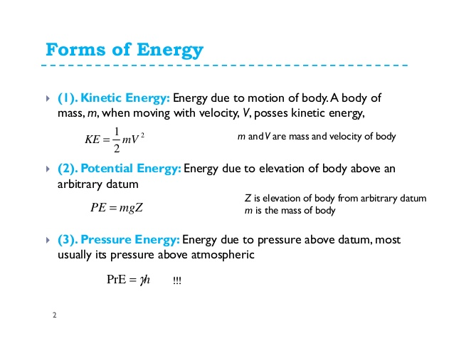

Slide 25
THANK
YOU

