Slide 1
Surveying- 1

Slide 3
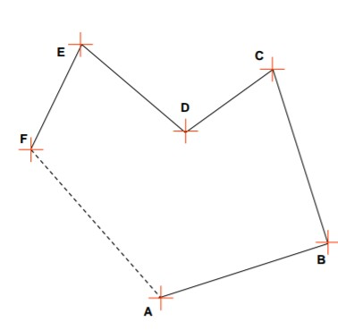
Measurements
Linear Measurement
Angular Measurement

Slide 7
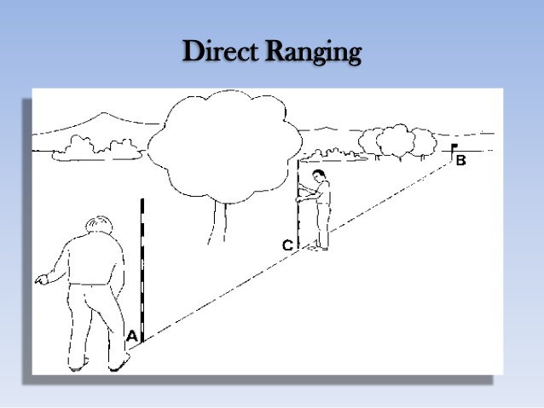
Operation in Chain Surveying
Ranging
Chaining
Offsetting

Slide 8
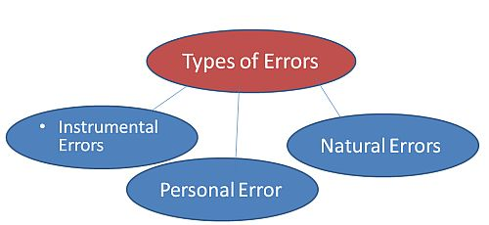

Slide 10
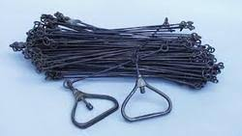

Slide 13
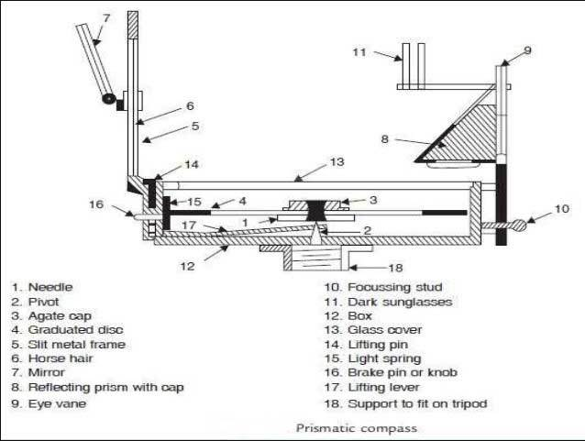
Prismatic Compass

Slide 15
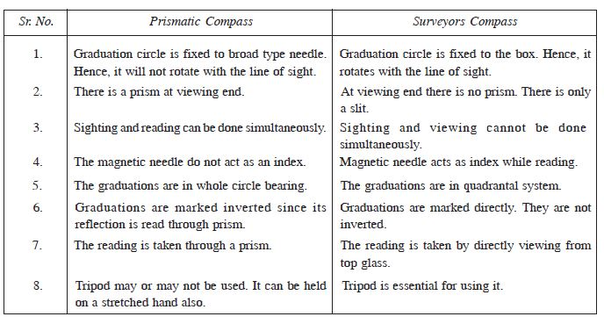

Slide 22
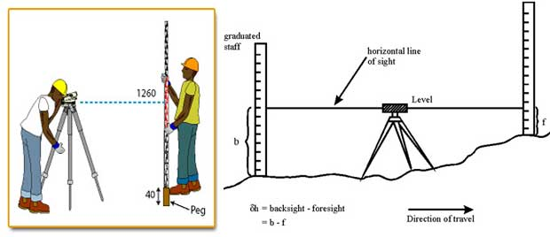

Slide 23
Reduction Of Level
Height of Instrument Method
Rise and Fall Method

Slide 24
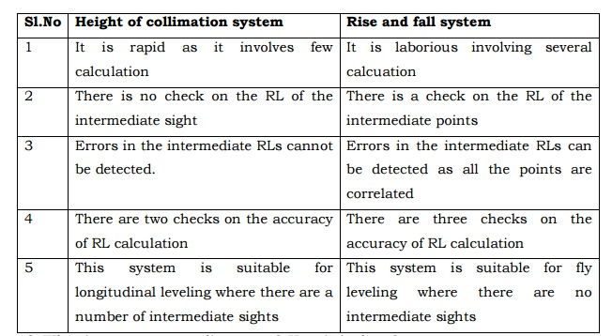

Slide 25
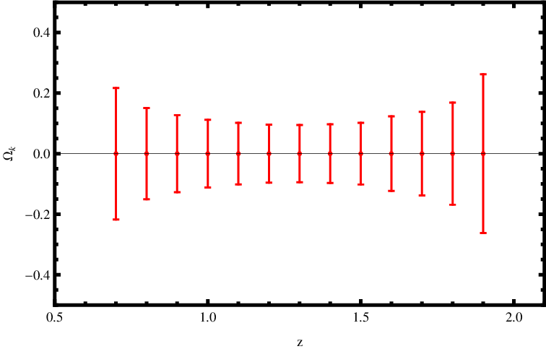
Errors in Levelling
Instrumental Error
Personal Error
Natural Error

Slide 26
THANK YOU

