Slide 1
ESTIMATING AND COSTING
SUBMITTED BY
LOKESH
ELECTRICAL ENGG.

Slide 2
House wiring
• In Homes typically have several kinds of home wiring, including a Electrical wiring for lighting and power distribution, permanently installed and portable appliances, telephone, heating or ventilation system control, and increasingly for home theatre and computer networks. [1]
• Safety regulations for wiring installation vary widely around the world, with national, regional, and municipal rules sometimes in effect. Some places allow the homeowner to install some or all of the wiring in a home; other jurisdictions require electrical wiring to be installed by licensed electricians only.

Slide 3
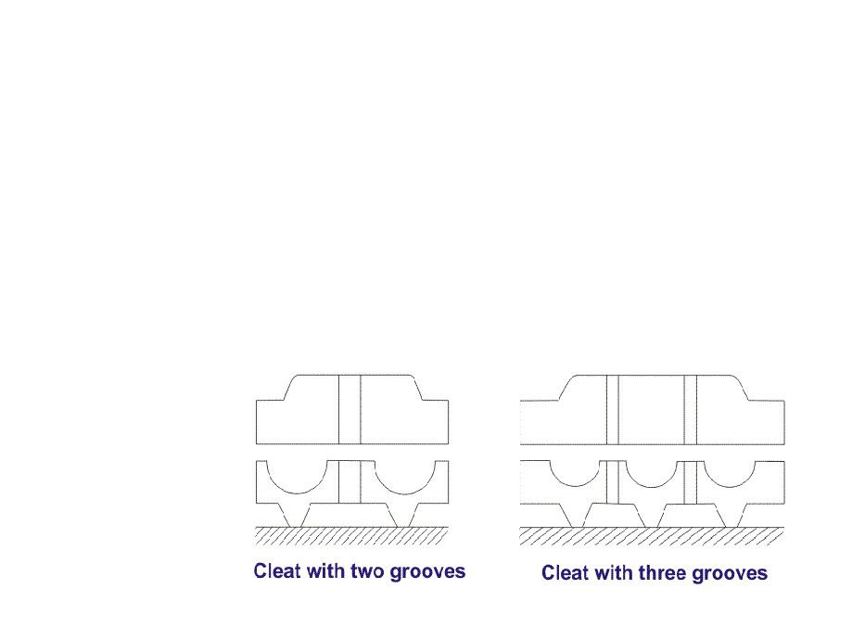
Cleat wiring
• Cleat wiring:- Electric wiring on cleats or insulated supports which are mounted on a wall or other surface, leaving the wiringexposed; conduits or raceways are not used.

Slide 4
Procedure of Cleat Wiring
• In this wiring VIR or PVC insulated wires are braided and compounded on walls or ceiling with the help of porcelain cleats. The wires can be weather proof.
Simple wire laying is done in this scheme of wiring.
In present days, this kind of wiring scheme is not recommended for house or building. Only in
temporary army campus or festival related pandels
this wiring is used.

Slide 5
Advantages of Cleat Wiring
• There are some advantages of this type of wiring. Cheap and easy wiring
• Easy to fault detection
• Easy to repair
• Alteration and addition is easy. Disadvantages of Cleat Wiring
• The disadvantages of this wiring are Bad appearance
• Exposed to weather to be affected by humidity, rain, smoke, sunlight etc
• Chances for shock or fire
• Used in only 220V in low ambient temperature.
• Not long lasting
• Sag happens

Slide 6
Casing Wiring
WiringMaterial Used in Casing
• VIR or PVC insulated wires
• Casing Enclosure (made of wood or plastic)
• Capping (made of wood or plastic)
• Casing and capping joints.

Slide 7
Procedure of Casing Wiring
This kind of winding is very old fashioned. Generally
PVC or VIR insulated wires are carried through the
casing enclosure and capping is used to cover the casing.

Slide 8
Batten Wiring
Group of Single or double or three core cables are used to be laid on straight teak wooden batten. The cables are hold with help of tinned brass link clip or buckle clip. Brass pins are used to fix the buckle clips on the wooden batten. Buckle clips is fixed with brass pin on the wooden batten at an interval 10 cm for horizontal runs and 15 cm
for vertical runs.

Slide 9
Advantages of Batten Wiring
The advantages of this kind of wiring are given below.
Cheap in material cost Easy installation
Appearance is better. Customization is easy
Less chance of leakage current
Disadvantages of Batten Wiring
❖ Not suitable for outdoor wiring
Humidity, smoke, steam etc directly affect on wires.
Heavy wires are not recommended for this wiring scheme.

Slide 10
ELECTRICAL INSTALLATIONS
An electrician works on commercial, residential, agricultural and industrial projects. There is a direct
relationship between the nature and quality of the
product required and the payment made by the customer. Therefore the electrician has a continuing responsibility to work professionally in order to meet the requirements of the customer and thus maintain and grow the business. Electrical installation is closely associated with other parts of the construction
industry, and with the many products that support it,
normally for commercial purposes.

Slide 11
Testing and Commissioning In Electrical Construction Works
At the completion of the electrical installation works, the entire installation shall be subject to the test before final placing in service under the full responsibility of the contractor. Unless Otherwise specifically called for all tests shall be carried out in conformity with IEE regulations. Contractor shall coordinate with the Client and the Supervising Engineer to get electricity from the local supply authority before starting of testing and commissioning.

Slide 13
Kinds of Electrical Installation Testing
Following tests shall be carried out: Wiring continuity test, Insulation resistance test, Earth continuity test, Earth resistivity test, Performance test, and any other tests as instructed by the Supervising Engineer.
1. Electrical Wiring Continuity Testing
All wiring system shall be tested for continuity of circuits, short circuits and earthing after wiring is completed and before energizing.
2. Electrical Insulation Resistance Testing
The insulation resistance shall be measured across earth and the whole
system of conductors, or any section thereof, with all fuses in place and all
switches closed and except in concentric wiring all lamps in position of both poles of the installation otherwise electrically connected together.
A direct current pressure of not less than twice the working pressure
provided that it does not exceed 660 V for medium voltage circuits. Where
the supply is divided from AC three phase system, the neutral pole of which is connected to earth, either direct or through added resistance, pressure shall be deemed to be that which is maintained between the phase conductor and the neutral.

Slide 14
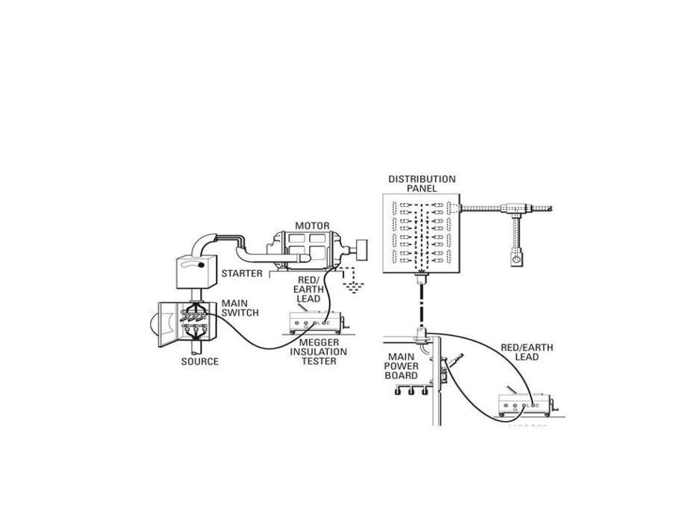
2. Electrical Insulation Resistance Testing(to be continued)
The insulation resistance measured as above shall not be less than 50 mega ohms divided by the number of points on the circuit provided that the whole installation, shall not be required to have an insulation resistance greater than one mega ohm

Slide 15
2. Electrical Insulation Resistance Testing(to be continued)
The insulation resistance shall also be measured between all conductors connected to one phase conductor of the supply and all the conductors connected to the middle wire to the neutral or to the other phase conductors to the supply. Such a test shall be carried out after removing all metallic
connections between the two poles of the installation and in these
circumstances the insulation shall not be less than that specified above.
3. Electrical Earth Continuity Path Testing
The earth continuity conductor metallic envelops of cables, shall be tested for electric continuity and the electrical resistance of the same along with the earthing lead but excluding any added resistance or earth leakage circuit breaker measured from the connection with the earth electrode to any point in the earth continuity conductor in the completed installation shall not exceed one ohm.

Slide 16
4. Electrical Testing of Non-linked Single Pole Switches
In a two wire installation a test shall be made to verify that all non linked single pole
switches have been fitted in the same conductor throughout, and such conductor shall be labeled or marked for connection, throughout, and such conductor shall be labeled or marked for connection to an outer or phase conductor or non earthed conductor a test shall be made three or four wire installation a test shall be made to verify that every non linked single pole switch is fitted in a conductor to one of the outer or phase conductor of the supply. The entire electrical installation shall be subject to the final acceptance of the Supervising engineer as well as the local authorities
5. Electrical Earth Resistivity Testing
Earth resistivity test shall be carried out in accordance with British Standard Code of Practice of Earthing. All tests shall be carried out in the presence of the Supervising Engineer.
6. Electrical Performance Testing
The complete electrical installation and equipment shall be subject to the final performance test as intended for each and every equipment shall be
tested as per the manufacturers instructions.

Slide 17
THANK YOU

