Slide 1
INSTUMENTATION
Submitted To:- Submitted by Mr. Manish Aggarwal Mr. Lokesh
H.O.D Electrical Engg

Slide 2
TOPICS
1) Measurement
2) Transducer
3) Measurement of displacement and Strain
4) Force and torque Measurement
5) Pressure measurement
6) Flow measurement
7) Measurement of temperature
8) Measurement of Other non-electrical quantity such as humidity , pH, level and vibrations

Slide 3
Measurement
Measurement is the assignment of a number to a characteristic of an object or event, which can be compared with other objects or events.[1][2] The scope and application of a measurement is dependent on the context and discipline. In the natural sciences and engineering, measurements do not apply to nominal properties of objects or events, which is consistent with the guidelines of the International vocabulary of metrology published by the International Bureau of Weights and Measures.[2] However, in other fields such as statistics as well as the social and behavioral sciences, measurements can have multiple levels, which would include nominal, ordinal, interval, and ratio scales.
Measurement is a cornerstone of trade, science, technology, and quantitative research in many disciplines. Historically, many measurement systems existed for the varied fields of human existence to facilitate comparisons in these fields. Often these were achieved by local agreements between trading partners or collaborators. Since the 18th century, developments progressed towards unifying, widely accepted standards that resulted in the modern International System of Units (SI). This system reduces all physical measurements to a mathematical combination of seven base units. The science of measurement is pursued in the field of metrology.

Slide 4
Importance of Measurement
Measurements play an important role in daily life because they are useful to do basic tasks, such as take a child's temperature with a thermometer, make time estimations, measure out medicine and find weights, areas and volumes of different materials or substances. For examples, people use measurements in simple home task like cooking where one may need to use a weighing scale or read the temperature of an oven when baking foods

Slide 5
Transducer
This article is about an engineering device. For the similarly named concept in computer science, see Finite state transducer.
A transducer is a device that converts energy from one form to another. Usually a transducer converts a signal in one form of energy to a signal in another.
Transducers are often employed at the boundaries of automation, measurement, and control systems, where electrical signals are converted to and from other physical quantities (energy, force, torque, light, motion, position, etc.). The process of converting one form of energy to another is known as transduction.

Slide 6
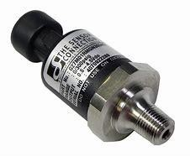
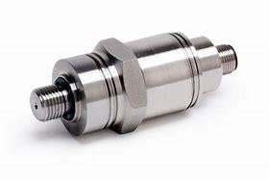

Slide 7
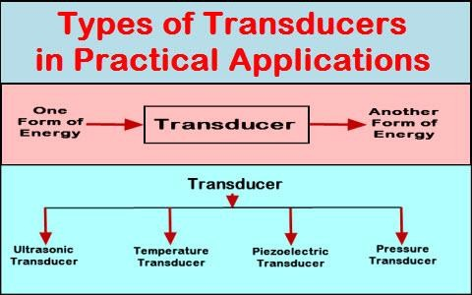
various types of transducer

Slide 8
measurement of strain gauge
A strain gauge is a device used to measure strain on an object. Invented by Edward E. Simmons and Arthur C. Ruge in 1938, the most common type of strain gauge consists of an insulating flexible backing which supports a metallic foil pattern. The gauge is attached to the object by a suitable adhesive, such as cyanoacrylate.[1] As the object is deformed, the foil is deformed, causing its electrical resistance to change. This resistance change, usually measured using a Wheatstone bridge, is related to the strain by the quantity known as the gauge factor.

Slide 9
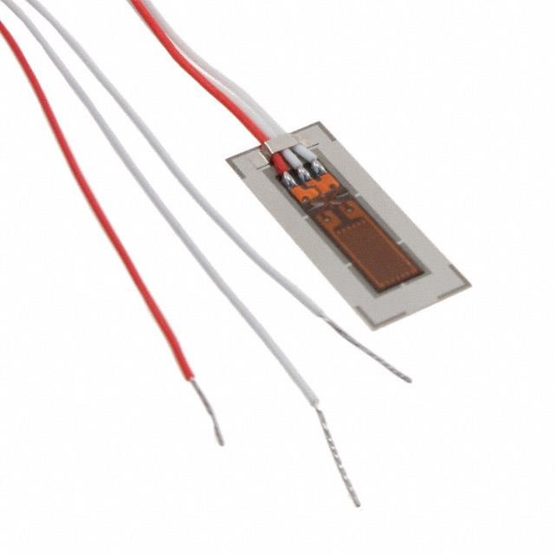
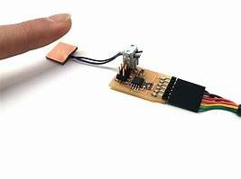
strain gauge

Slide 10
force measurement
In physics, a force is any interaction that, when unopposed, will change the motion of an object. A force can cause an object with mass to change its velocity (which includes to begin moving from a state of rest), i.e., to accelerate. Force can also be described intuitively as a push or a pull. A force has both magnitude and direction, making it a vector quantity. It is measured in the SI unit of newtons and represented by the symbol F.
The original form of Newton's second law states that the net force acting upon an object is equal to the rate at which its momentum changes with time. If the mass of the object is constant, this law implies that the acceleration of an object is directly proportional to the net force acting on the object, is in the direction of the net force, and is inversely proportional to the mass of the object.
Concepts related to force include: thrust, which increases the velocity of an object; drag, which decreases the velocity of an object; and torque, which produces changes in rotational speed of an object. In an extended body, each part usually applies forces on the adjacent parts; the distribution of such forces through the body is the internal mechanical stress. Such internal mechanical stresses cause no acceleration of that body as the forces balance one another. Pressure, the distribution of many small forces applied over an area of a body, is a simple type of stress that if unbalanced can cause the body to accelerate. Stress usually causes deformation of solid materials, or flow in fluids.

Slide 11
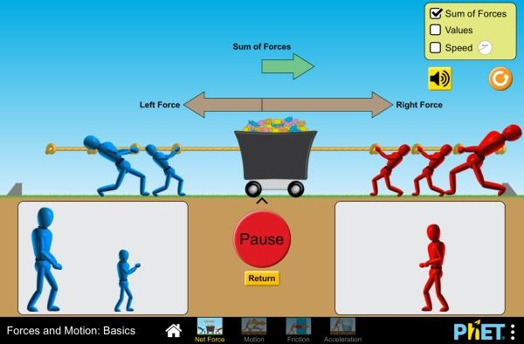

Slide 12
torque measurement
Torque, moment, or moment of force is rotational force. Just as a linear force is a push or a pull, a torque can be thought of as a twist to an object. In three dimensions, the torque is a pseudovector; for point particles, it is given by the cross product of the position vector (distance vector) and the force vector.

Slide 13
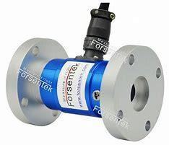
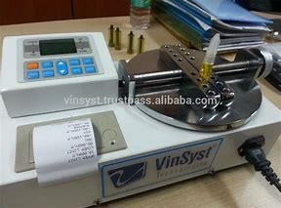
Devices

Slide 14
pressure measurement
Pressure measurement is the analysis of an applied force by a fluid (liquid or gas) on a surface. Pressure is typically measured in units of force per unit of surface area. Many techniques have been developed for the measurement of pressure and vacuum. Instruments used to measure and display pressure in an integral unit are called pressure gauges or vacuum gauges. A manometer is a good example as it uses a column of liquid to both measure and indicate pressure. Likewise the widely used Bourdon gauge is a mechanical device which both measures and indicates and is probably the best known type of gauge.
A vacuum gauge is a pressure gauge used to measure pressures lower than the ambient atmospheric pressure, which is set as the zero point, in negative values (e.g.:
-15 psi or -760 mmHg equals total vacuum). Most gauges measure pressure relative to atmospheric pressure as the zero point, so this form of reading is simply referred to as "gauge pressure". However, anything greater than total vacuum is technically a form of pressure. For very accurate readings, especially at very low pressures, a gauge that uses total vacuum as the zero point may be used, giving pressure readings in an absolute scale.
Other methods of pressure measurement involve sensors which can transmit the pressure reading to a remote indicator or control system (telemetry).

Slide 15
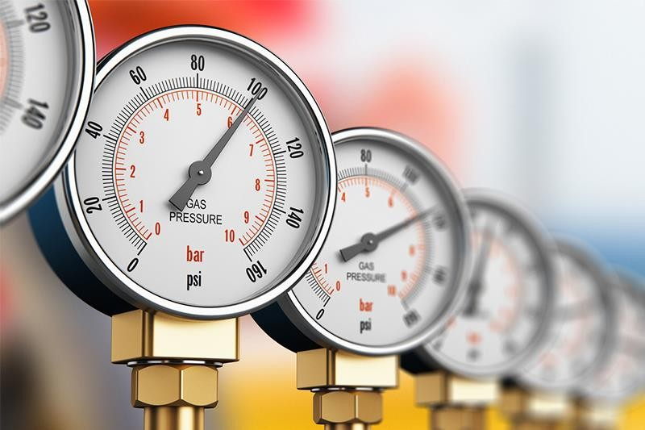
Pressure measuring device

Slide 16
pressure cell
Rheology under pressure is used to simulate process conditions, to measure above the boiling point, or to prevent sample evaporation. The pressure cell specifications are therefore tailored to each application. In the petrochemical industries, high pressures of up to 1000 bar and temperatures of up to 300 °C are required, whereas work with low-viscosity solvents requires a sensitive, yet fully closed system. To cover these diverse applications, a range of different pressure cells and measuring systems is available.

Slide 17
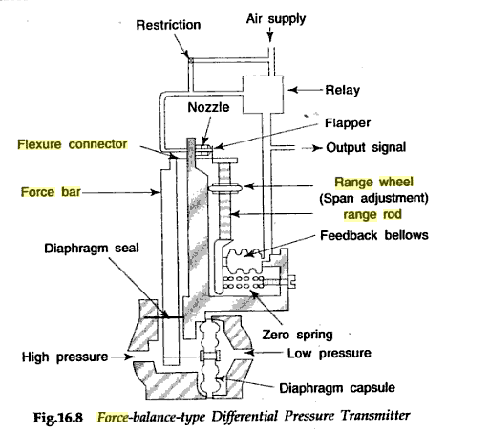
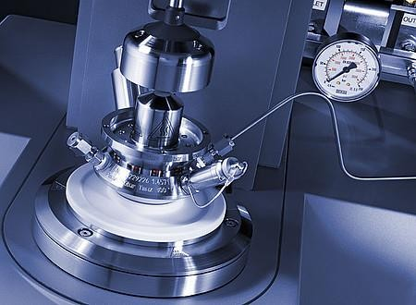

Slide 18
flow measurement
Flow measurement is the quantification of bulk fluid movement. Flow can be measured in a variety of ways. Positive-displacement flow meters accumulate a fixed volume of fluid and then count the number of times the volume is filled to measure flow. Other flow measurement methods rely on forces produced by the flowing stream as it overcomes a known constriction, to indirectly calculate flow. Flow may be measured by measuring the velocity of fluid over a known area. For very large flows, tracer methods may be used to deduce the flow rate from the change in concentration of a dye or radioisotope.

Slide 19
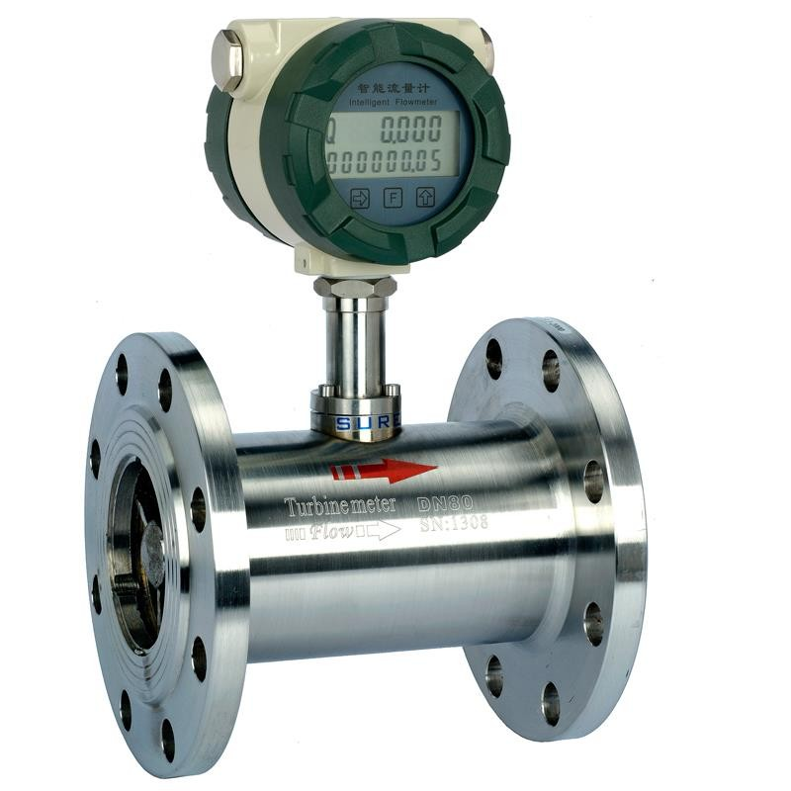
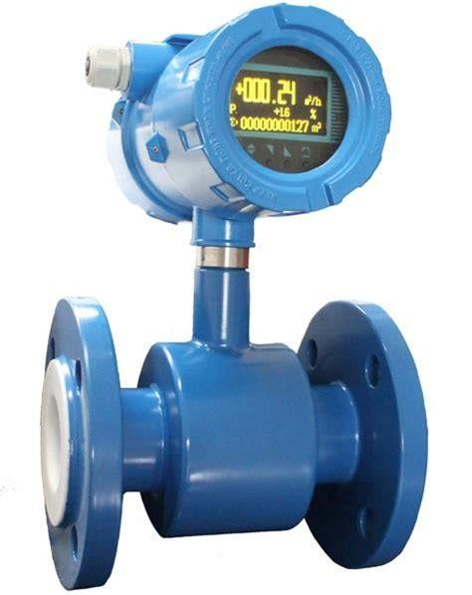

Slide 20
Ultrasonic flow meter
Principle
Density is measured according to absorption method. A radioactive source (Cs-137) contained in a lead-shield, steel- enclosed housing is mounted on one side of pipe with a scintillation detector on the opposite side. Gamma energy emitted from the source passes through the pipe and the process material. The amount of energy reaching the detector changes with the density change of the material being measured. Density is determined based on energy attenuation and fluid concentration or solid content is calculated via density

Slide 21
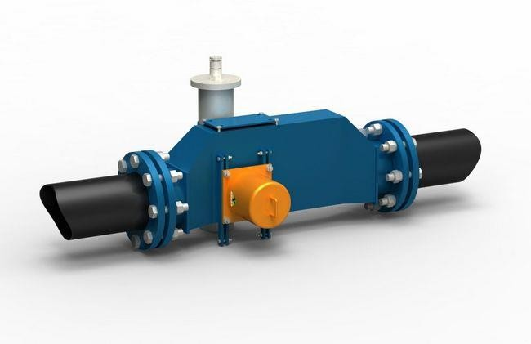

Slide 22
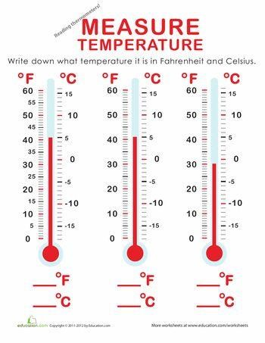
Measurement of temperature
Temperature measurement, also known as thermometry, describes the process of measuring a current local temperature for immediate or later evaluation. Datasets consisting of repeated standardized measurements can be used to assess temperature trends

Slide 23
Thermocouple
A thermocouple is an electrical device consisting of two dissimilar electrical conductors forming electrical junctions at differing temperatures. A thermocouple produces a temperature-dependent voltage as a result of the thermoelectric effect, and this voltage can be interpreted to measure temperature. Thermocouples are a widely used type of temperature sensor
Commercial thermocouples are inexpensive, interchangeable, are supplied with standard connectors, and can measure a wide range of temperatures. In contrast to most other methods of temperature measurement, thermocouples are self powered and require no external form of excitation. The main limitation with thermocouples is accuracy; system errors of less than one degree Celsius (°C) can be difficult to achieve.
Thermocouples are widely used in science and industry. Applications include temperature measurement for kilns, gas turbine exhaust, diesel engines, and other industrial processes. Thermocouples are also used in homes, offices and businesses as the temperature sensors in thermostats, and also as flame sensors in safety devices for gas-powered appliances

Slide 24
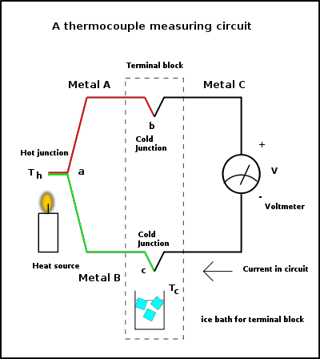

Slide 25
pH meter
A pH meter is a scientific instrument that measures the hydrogen-ion activity in water-based solutions, indicating its acidity or alkalinity expressed as pH. The pH meter measures the difference in electrical potential between a pH electrode and a reference electrode, and so the pH meter is sometimes referred to as a "potentiometric pH meter". The difference in electrical potential relates to the acidity or pH of the solution. The pH meter is used in many applications ranging from laboratory experimentation to quality control.

Slide 26
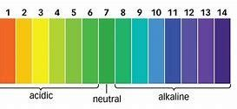

Slide 27
pH
In chemistry, pH (potential of hydrogen) is a numeric scale used to specify the acidity or basicity of an aqueous solution. It is approximately the negative of the base 10 logarithm of the molar concentration, measured in units of moles per liter, of hydrogen ions. More precisely it is the negative of the base 10 logarithm of the activity of the hydrogen ion.Solutions with a pH less than 7 are acidic and solutions with a pH greater than 7 are basic. Pure water is neutral, at pH 7 (25 °C), being neither an acid nor a base. Contrary to popular belief, the pH value can be less than 0 or greater than 14 for very strong acids and bases respectively.
Measurements of pH are important in agronomy, medicine, biology, chemistry, agriculture, forestry, food science, environmental science, oceanography, civil engineering, chemical engineering, nutrition, water treatment and water purification, and many other applications.
The pH scale is traceable to a set of standard solutions whose pH is established by international agreement. Primary pH standard values are determined using a concentration cell with transference, by measuring the potential difference between a hydrogen electrode and a standard electrode such as the silver chloride electrode. The pH of aqueous solutions can be measured with a glass electrode and a pH meter, or an indicator

Slide 28
Vibration
Vibration is a mechanical phenomenon whereby oscillations occur about an equilibrium point. The word comes from Latin vibrationem ("shaking, brandishing"). The oscillations may be periodic, such as the motion of a pendulum—or random, such as the movement of a tire on a gravel road.
Vibration can be desirable: for example, the motion of a tuning fork, the reed in a woodwind instrument or harmonica, a mobile phone, or the cone of a loudspeaker.
In many cases, however, vibration is undesirable, wasting energy and creating unwanted sound. For example, the vibrational motions of engines, electric motors, or any mechanical device in operation are typically unwanted. Such vibrations could be caused by imbalances in the rotating parts, uneven friction, or the meshing of gear teeth. Careful designs usually minimize unwanted vibrations.
The studies of sound and vibration are closely related. Sound, or pressure waves, are generated by vibrating structures (e.g. vocal cords); these pressure waves can also induce the vibration of structures (e.g. ear drum). Hence, attempts to reduce noise are often related to issues of vibration.

Slide 29
Vibration level

